Slide 1
REBCO Work for Alexis

Slide 2
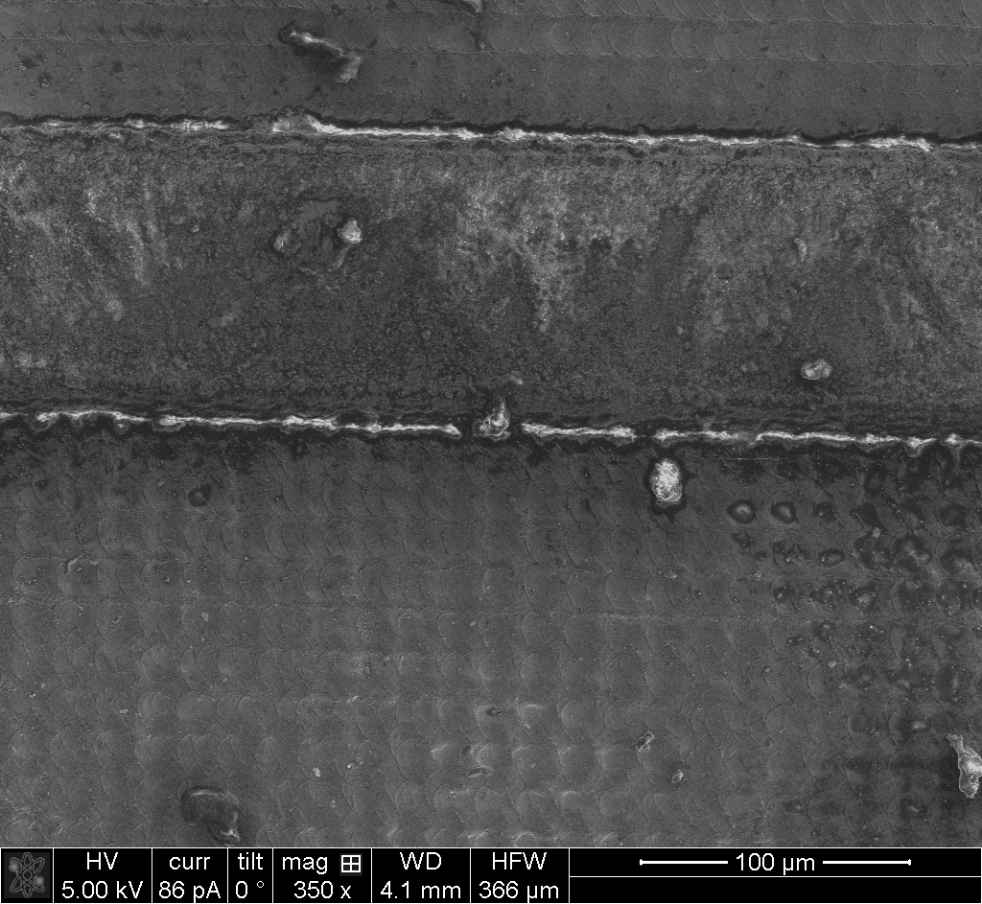
Wide field of view
the bridge

Slide 3
After 30kV, 93pA cleaning cross section
30kV, 21nA → large trench
30kV, 2.8nA → cleaning cross section
30kV, 93pA → cleaning cross section

Slide 4
After 5kV, 93pA cleaning cross section
5kV, 450pA → cleaning cross section

Slide 5
Comparison of bridge and pristine surface
bridge surface →

Slide 6
Sr
Zoom series (left to right zooms in) of surface features to the left of the bridge
Notice the grain-like texture.
Grains appear to be 1-5um in diameter.

Slide 7

Ag layer results
took 25 measurements by hand

Slide 8
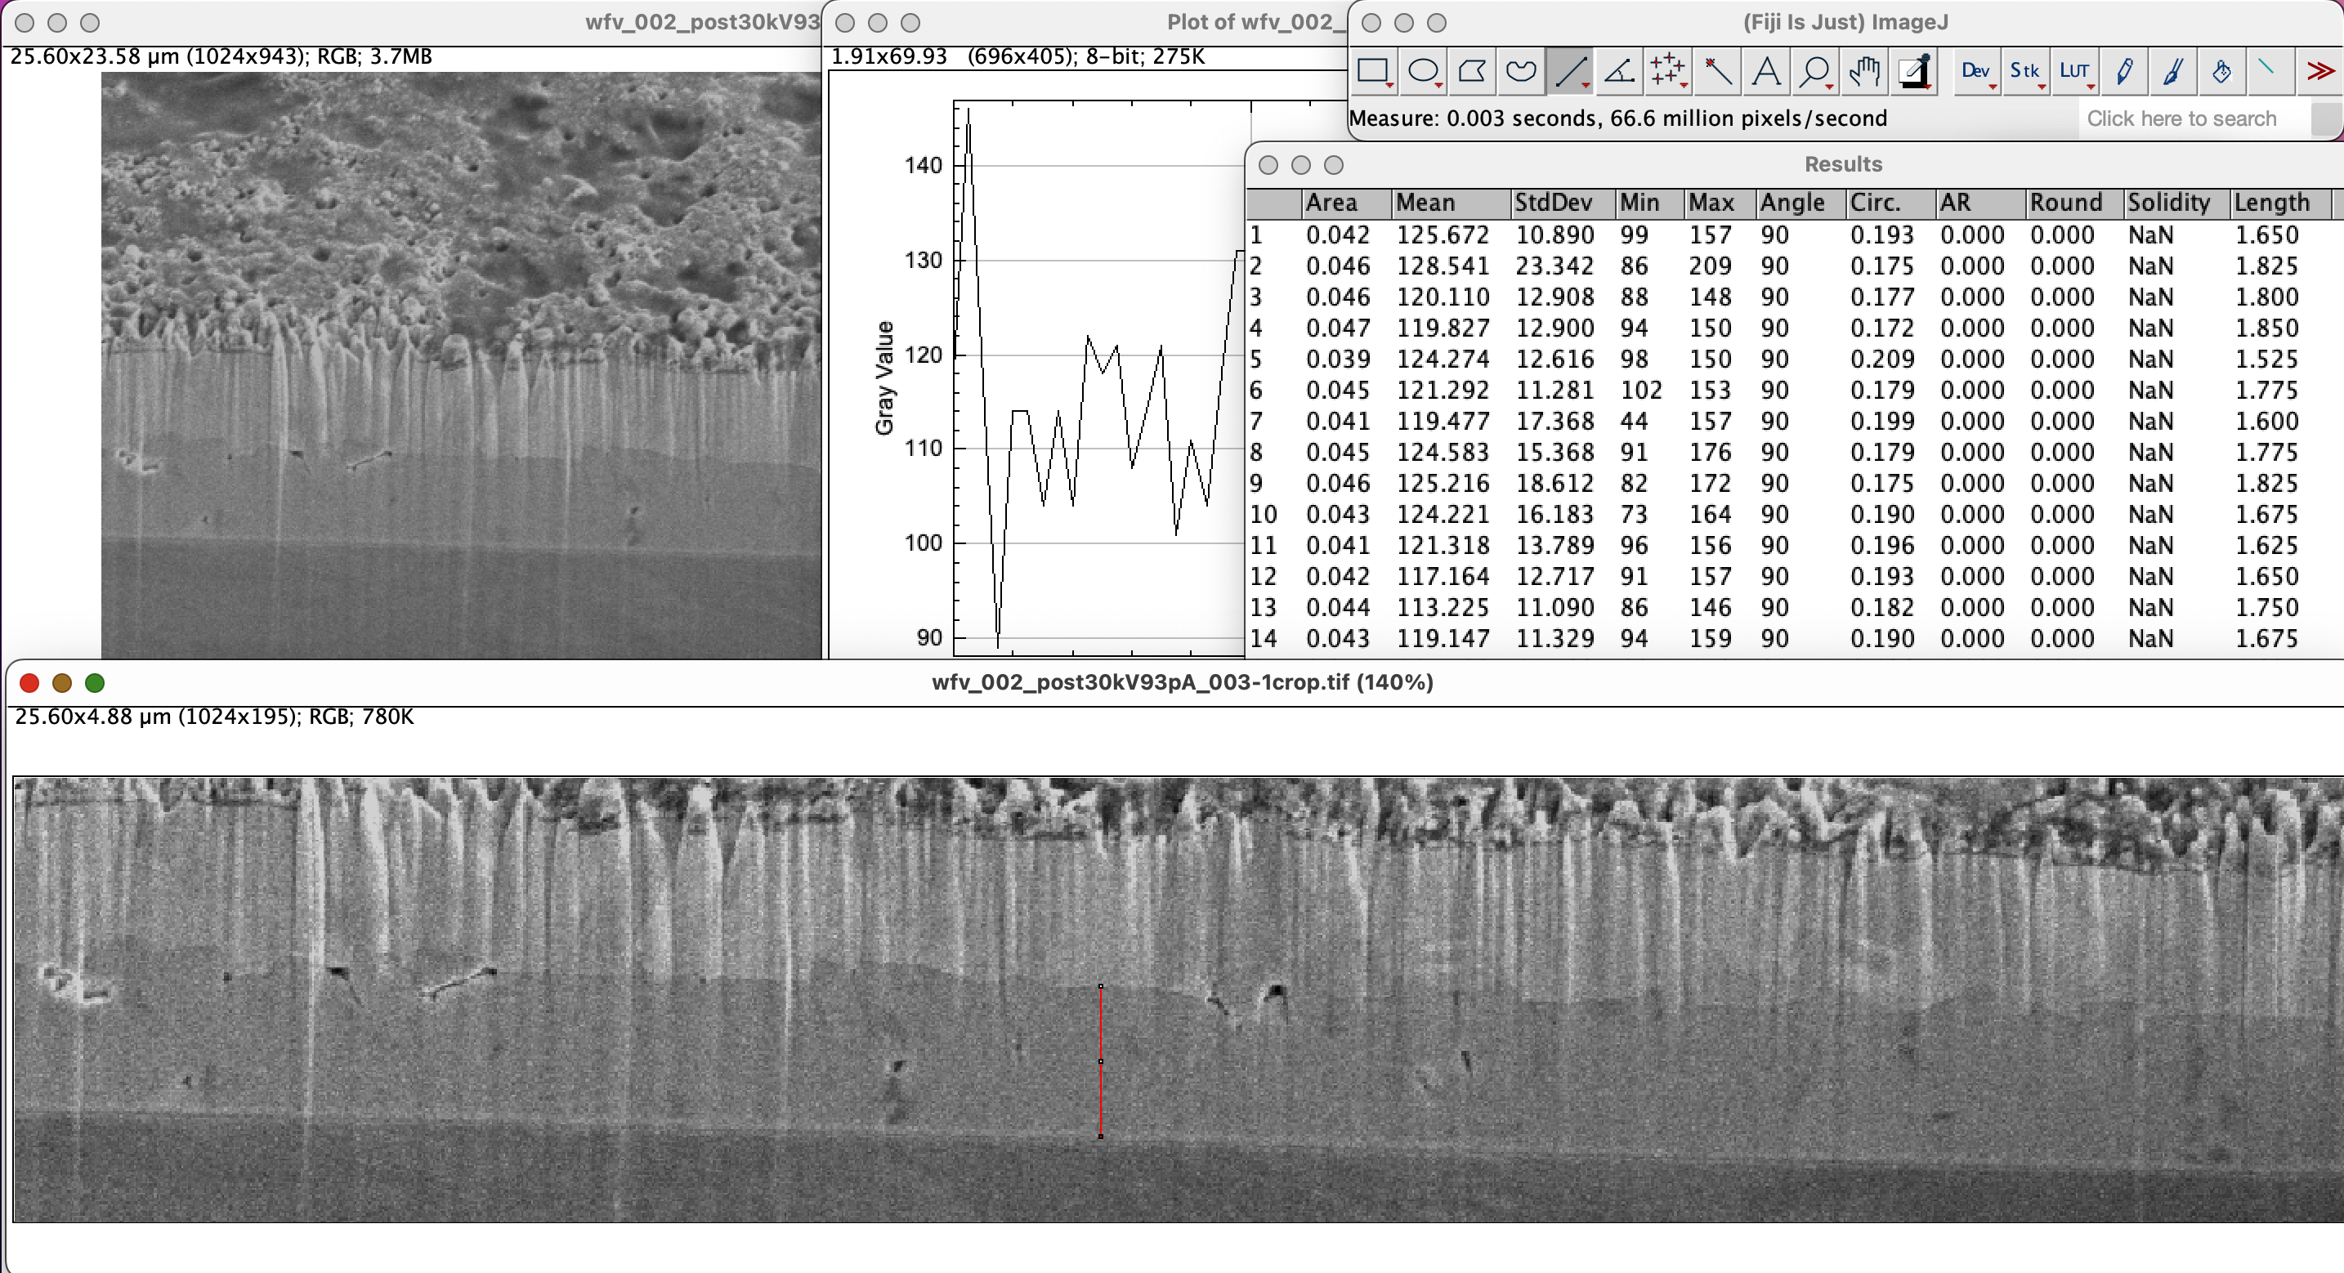

REBCO Layer results
the bridge
took 36 measurements by hand (right image shows how I did it → line measurement tool in ImageJ, went from left to right in jumps of ~1um so should sampling of this specific cut is pseudo-random)

Slide 9
Sr
the bridge
5kV, 450pA → cleaning cross section

Slide 10
Sr
the bridge
5kV, 450pA → cleaning cross section

Slide 11
Sr
the bridge
5kV, 450pA → cleaning cross section

Slide 12
Sr
the bridge
5kV, 450pA → cleaning cross section

Slide 13
Sr
the bridge
5kV, 450pA → cleaning cross section

Slide 14
Sr
the bridge
5kV, 450pA → cleaning cross section

Slide 15
Sr
the bridge
5kV, 450pA → cleaning cross section

